Slide 1

Packages
Notes:
1

Slide 2
Agenda
Introduction to Packages
Need for packages
Access protection using packages
Notes:
2

Slide 3
Package is similar to folders in your Disk
People normally group their related data in various folders.
For example, a programmer may group his programs into the following folders.
C_programs, CPP_programs, SQL_queries, java_programs.. etc.
We also use sub-folders for organizing our data more conveniently.
The advantage is we can easily locate the files if they are organized.
Notes:
3

Slide 4
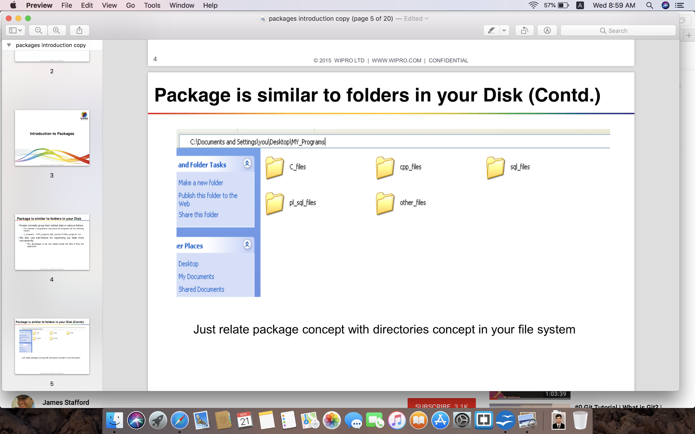
Package is similar to folders in your Disk (Contd.)
Notes:
4

Slide 5
Package is similar to folders in your Disk (Contd.)
Need for packages
Till now, you did not use any package since all your classes were stored in the default package. Imagine a situation where all the classes are stored in one package. It would lead to tremendous confusion as it may lead to classes with similar names that is not allowed by the language.
This scenario is also referred to as a namespace collision.
Notes:
5

Slide 6
Organizing classes into Packages
Packages are containers for classes and interfaces
Classes and interfaces are grouped together in containers
called packages
To avoid namespace collision, we put the classes into
separate containers called packages
Whenever you need to access a class, you access it through its package by prefixing the class with the package name
Notes:
6

Slide 7
Need for Packages
Packages are containers used to store the classes and interfaces into manageable units of code.
Packages also help control the accessibility of your classes. This is also called as visibility control.
Example:
package MyPackage;
class MyClass {...}
class YourClass{...}
Notes:
7

Slide 8
Access Protection using Packages
Packages facilitate access-control
Once a class is packaged, its accessibility is controlled by its package
That is, whether other classes can access the class in the package depends on the access specifiers used in its class declaration
There are four visibility control mechanisms packages offer:
private
no-specifier (default access)
protected
public
Notes:
8

Slide 9
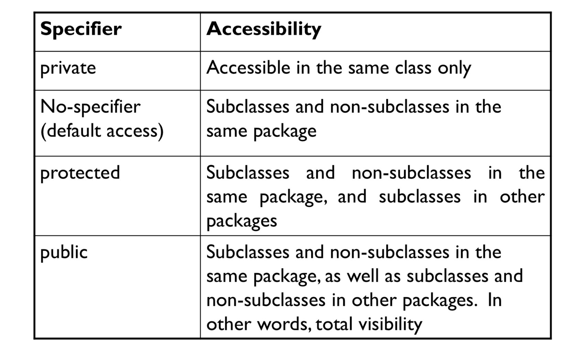
Packages & Access Control
Notes:
9

Slide 10
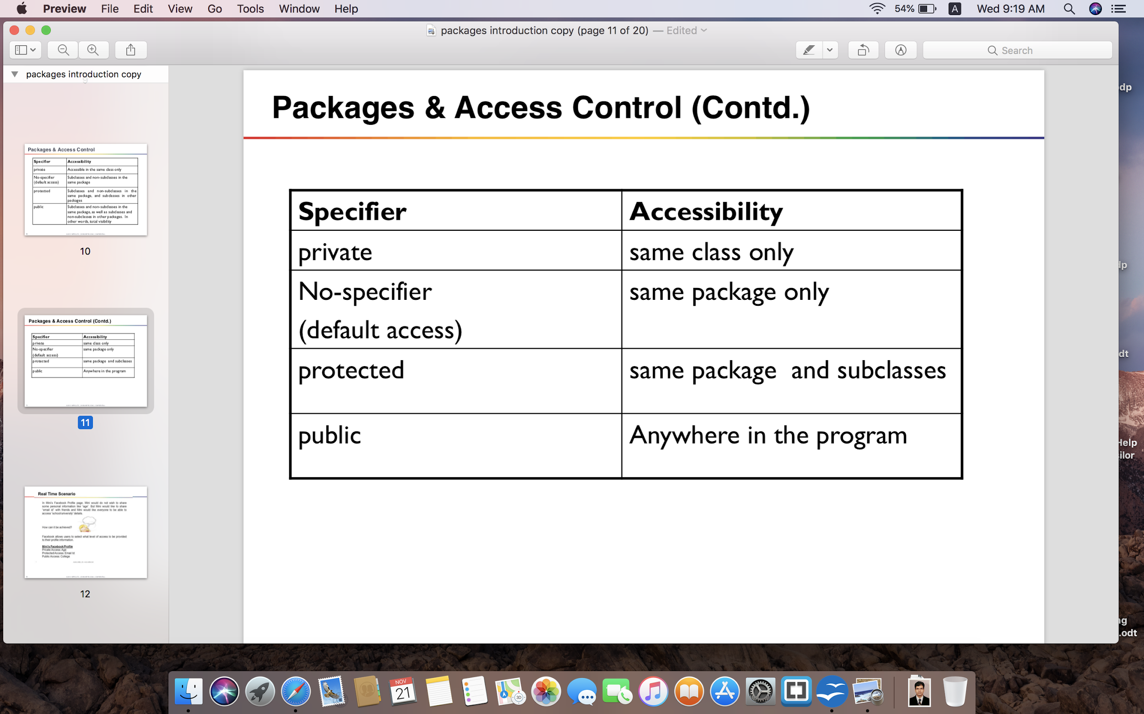
Packages & Access Control (Contd.)
Notes:
10

Slide 11
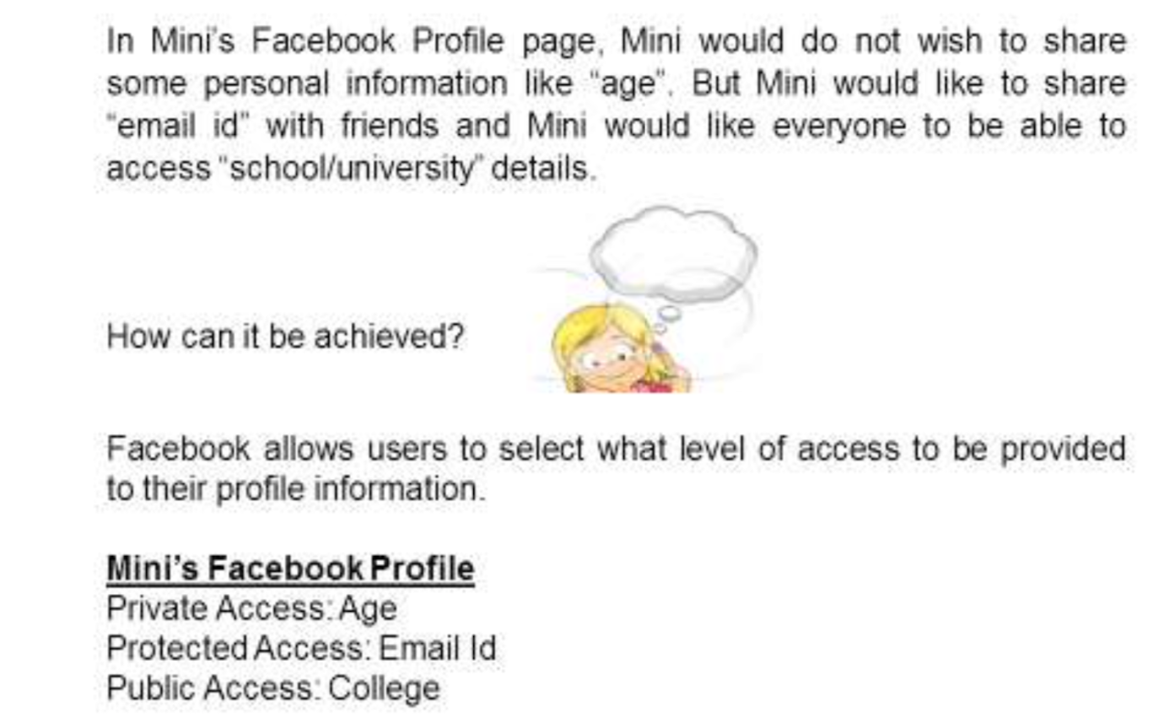
Real Time Scenario
Notes:
11

Slide 12
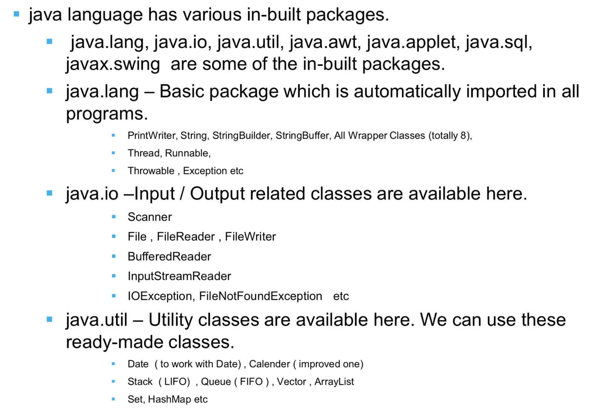
Inbuilt Packages
Notes:
12

Slide 13
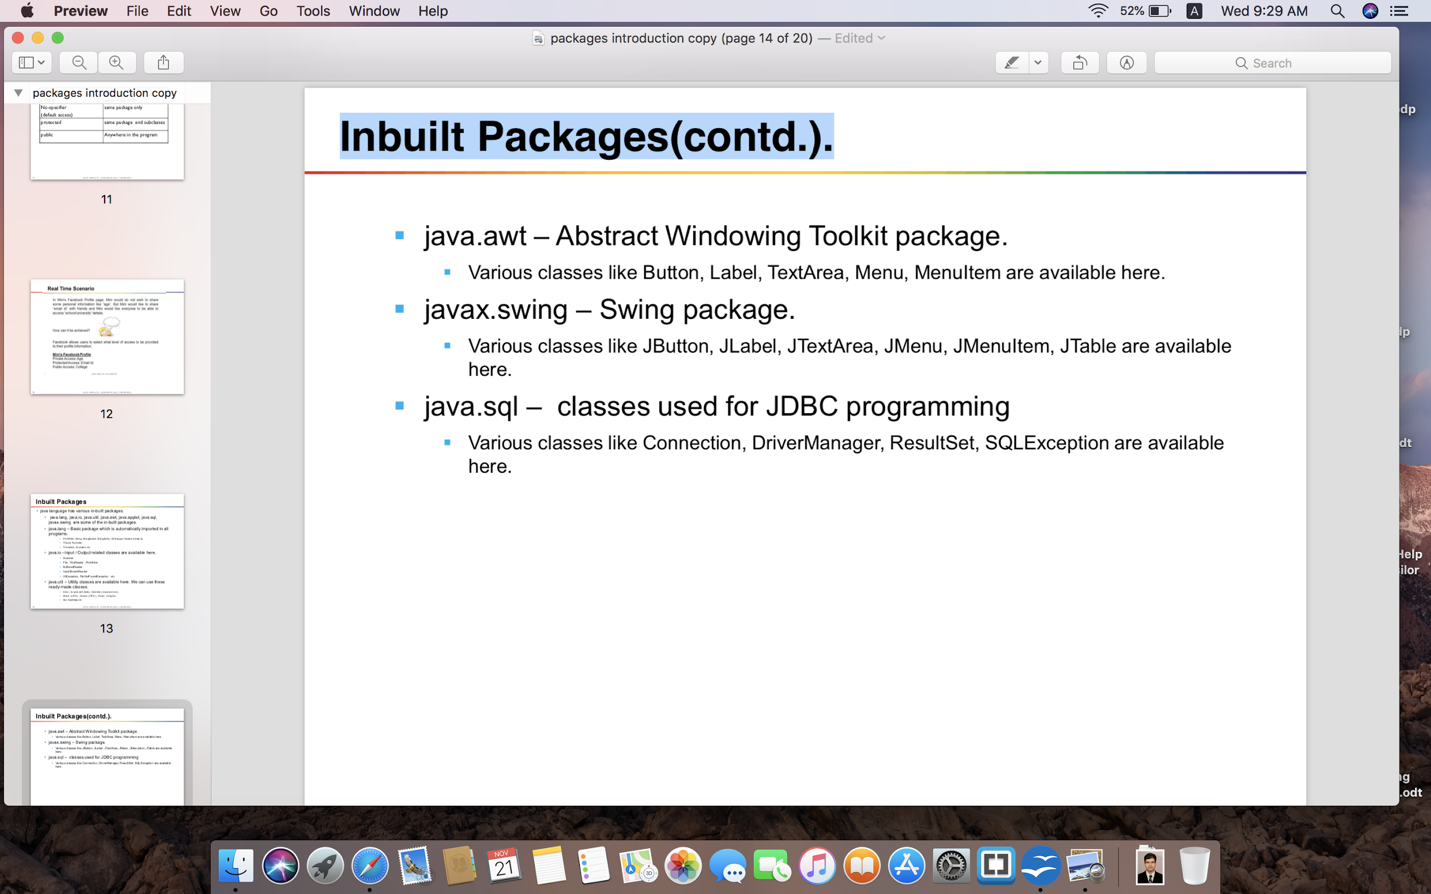
Inbuilt Packages(contd.).
Notes:
13

Slide 14
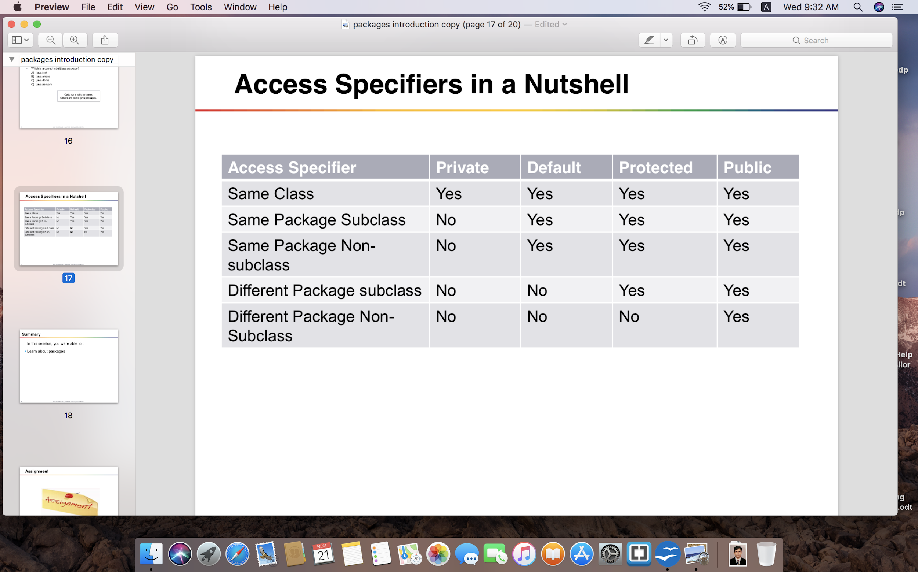
Access Specifiers in a Nutshell
Notes:
14

Slide 15
Hands-on Assignment
Create a package called test package;
Define a class called foundation inside the test package;
Inside the class, you need to define 4 integer variables;
Var1 as private;
Var2 as default;
Var3 as protected;
Var4 as public;
Import this class and packages in another class.
Try to access all 4 variables of the foundation class and see what variables are accessible and what are not accessible.
Notes:
15

Slide 16
Hands-on Assignment
1.1. Create a class called GeneralBank which acts as base class for all banks. This class has functionality getSavingInterestRate and getFixedInterestRate methods, which return the saving a/c rate of interest and fixed account rate of interest the specific bank gives. Since GeneralBank cannot say what percentage which bank would give, make it abstract.
1.2. Create 2 subclasses of GeneralBank called ICICIBank and KotMBank. Override the methods from base class. ICICI - Savings 4% Fixed 8.5% and KotMBank. - Savings 6% Fixed 9%
1.3. Create a main method to test the above classes. Try one by one and absorb your finding.
a) ICICIBank object reference instantiated with ICICIBank class.
b) KotMBank object reference instantiated with KotMBank class.
c) GeneralBank object reference instantiated with KotMBank class.
d) GeneralBank object reference instantiated with ICICIBank class.
Notes:
16

Slide 17
Hands-on Assignment
Write an interface called Playable, with a method
void play();
Let this interface be placed in a package called music.
Write a class called Veena which implements Playable interface. Let this class be placed in a package music.string
Write a class called Saxophone which implements Playable interface. Let this class be placed in a package music.wind
Write another class Test in a package called live. Then,
a. Create an instance of Veena and call play() method
b. Create an instance of Saxophone and call play() method
c. Place the above instances in a variable of type Playable and then call play()
Notes:
17

Slide 18
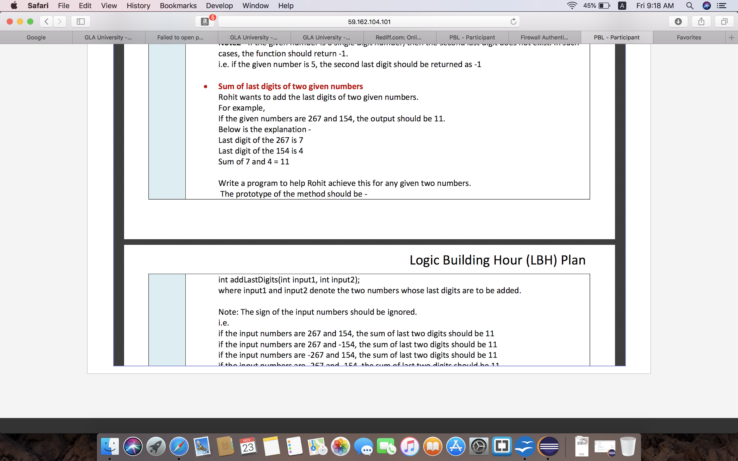
Hands-on Assignment
Notes:
18

